Slide 1

CUSTOMER RETENTION CASESTUDY
Submitted by-
Sujit Kumar

Slide 2
Problem Statement Analysis
Customer satisfaction is ecommerce platform is a key parameter for customer retention.
Success of any online shopping store has been defined in a few key metrices like service quality, system quality, information quality, trust & benefit.
For this we have collected a dataset and want to know what are factors to that are very crucial for customer feedback while purchasing a product online
We have done some data analysis to provide valuable insights that helps understand the customer better.

Slide 3
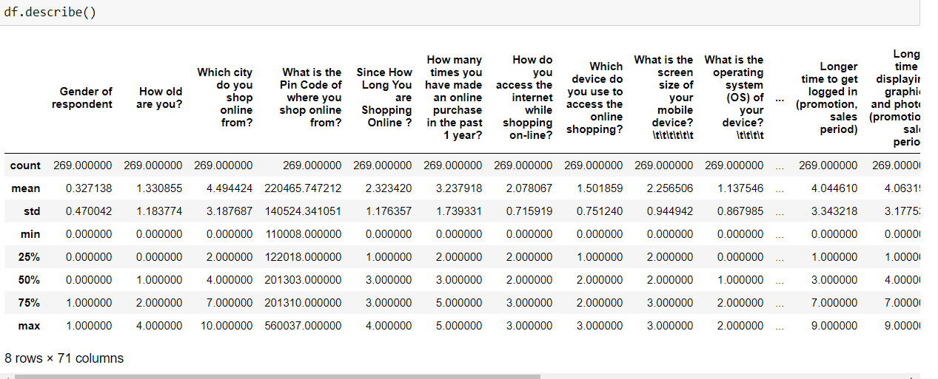
Exploratory Data Analysis Process
From the above describe method, we find out that how the each parameters are distributed across the dataset, From this method we got to know the five point summary analysis like mean, max and the quartiles.

Slide 4

Exploratory Data Analysis Process
Using the shape we find out the total number of rows & columns present in the dataset.

Slide 5
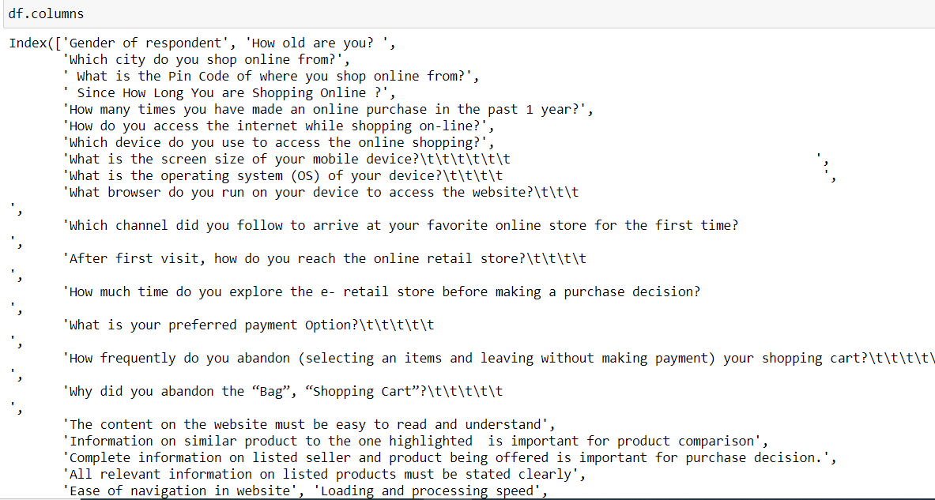
Exploratory Data Analysis Process
By using columns function we find out name of each columns available in the dataset.

Slide 6
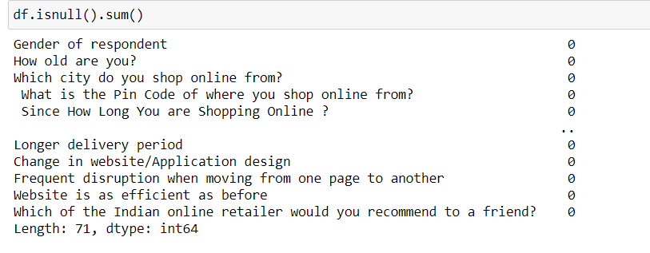
Exploratory Data Analysis Process
From this function we find out the number of null values available in each columns that is the number of missing values available in each column, in this sample data we do not have any null values present.

Slide 7
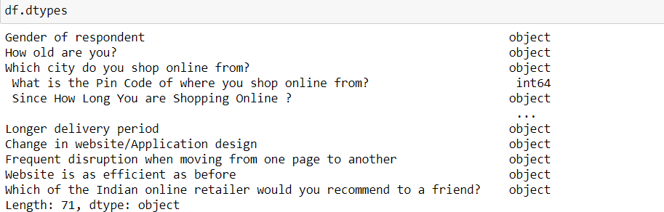
Exploratory Data Analysis Process
By using “dtypes” we got to know the data types for each of the columns present in the dataset.

Slide 8
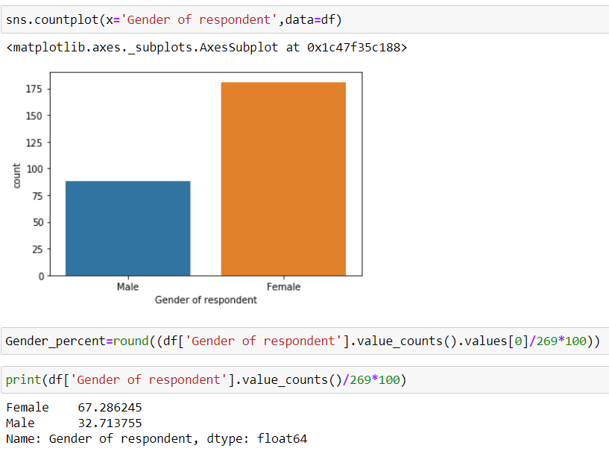
Data Visualization Process
From the above count plot we got to know the respondent percentage of gender that is distributed across the whole dataset using the seaborn library.

Slide 9
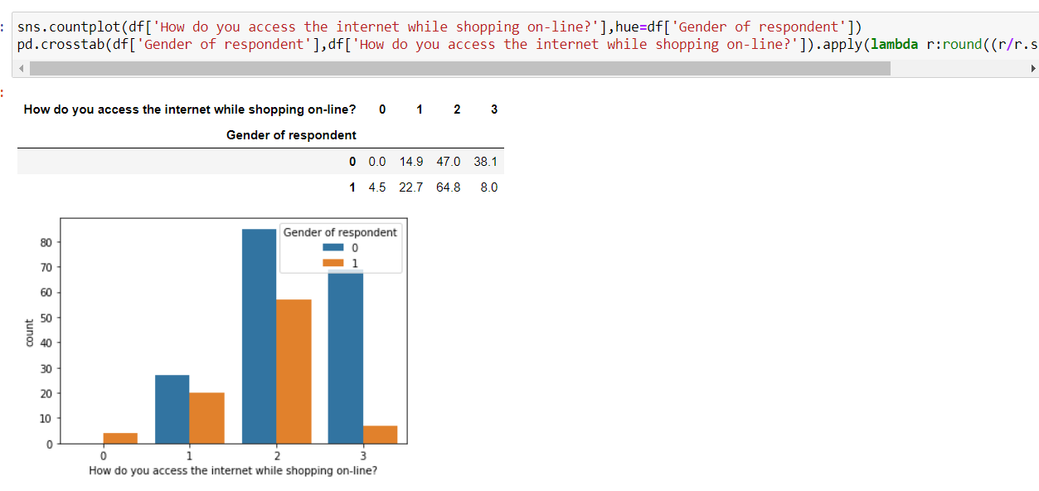
Data Visualization Process
From the above count plot, we find out gender wise distribution of data for how the access the internet while shopping online using the crosstab function that build the data in a group.

Slide 10
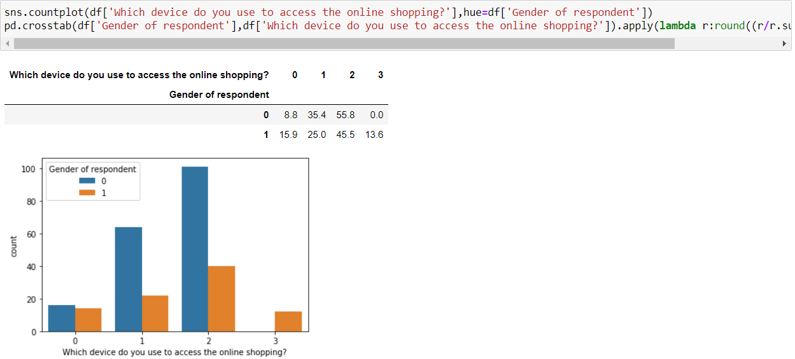
Data Visualization Process
From the above visualization we understand the device customers do for online shopping, so devices are like desktop, laptop, tablet, Smartphone etc. we have segregated it gender wise.

Slide 11
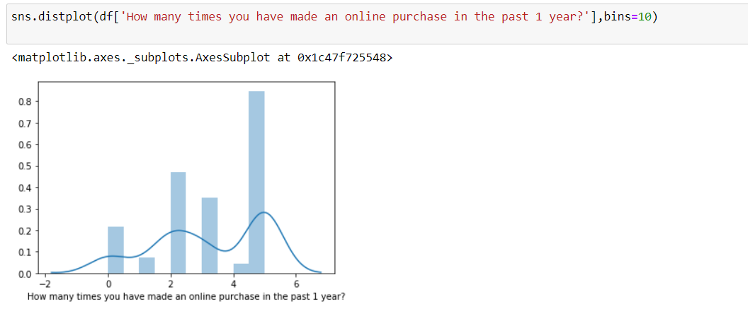
Data Visualization Process
From the above distributed plot, we got understand how data are distributed for the purchase that was done for the past one year. From this we got to know that people mostly 31 to 40 times in the last one year and out of which 75 percent are female customers.

Slide 12
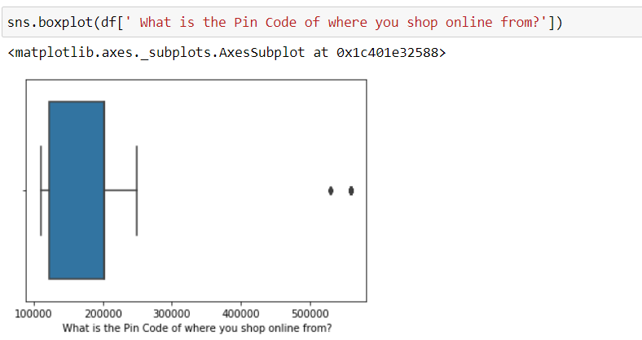
Data Visualization Process
From the above box plot we find out the pin code location of the customers and more than 95 percentage of customers belong to North India. (NCR region).

Slide 13
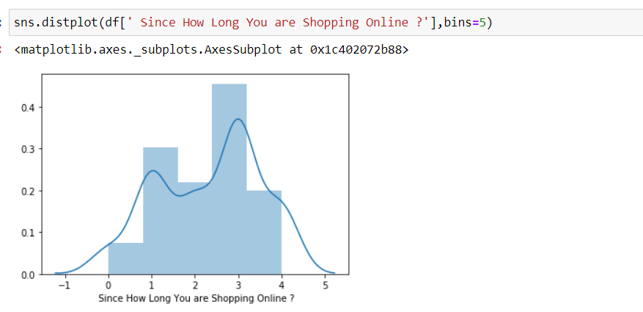
Data Visualization Process
From the above distribution plot using the seaborn library we find how long they are shopping online, and we got know 35 percentage of the overall dataset of customers are shopping online for more than 4 years and out of which more than 70 percent are female customers.

Slide 14
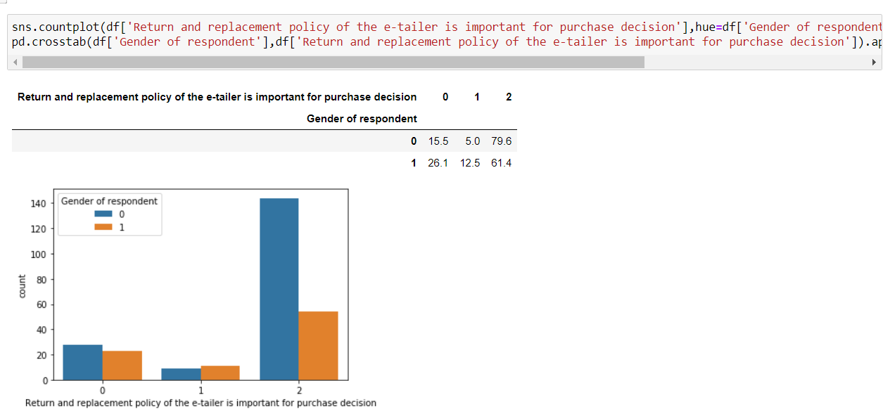
Data Visualization Process
Return a product is an import aspect from any eCommerce platform and mostly customer expect a hassle-free return and more than 70 percentage of customer strongly agreed for it for this sample dataset.

Slide 15
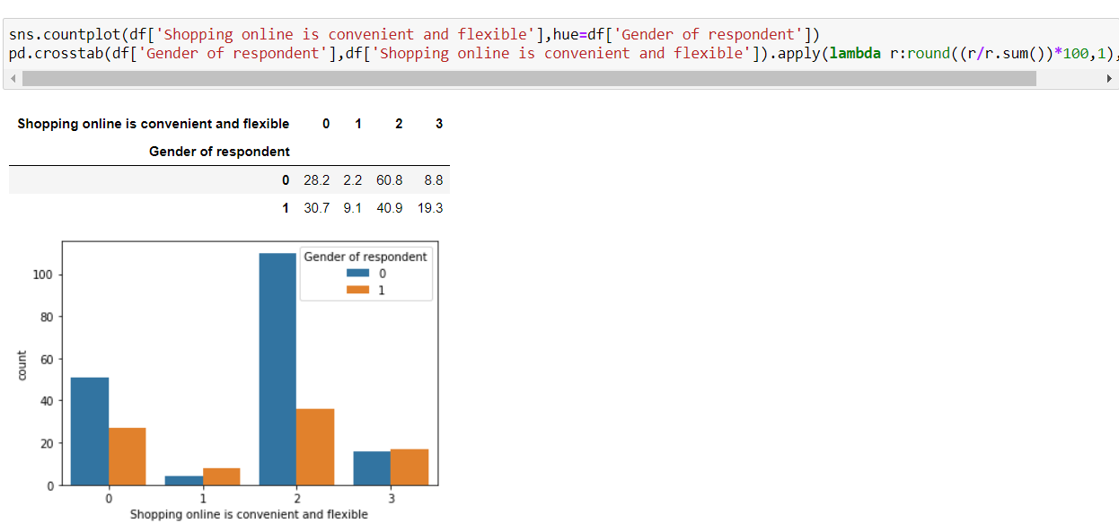
Data Visualization Process
From the above count plot, we got to know shopping online is convenient and flexible and more than 18 percentage of the people strongly agreed for it.

Slide 16
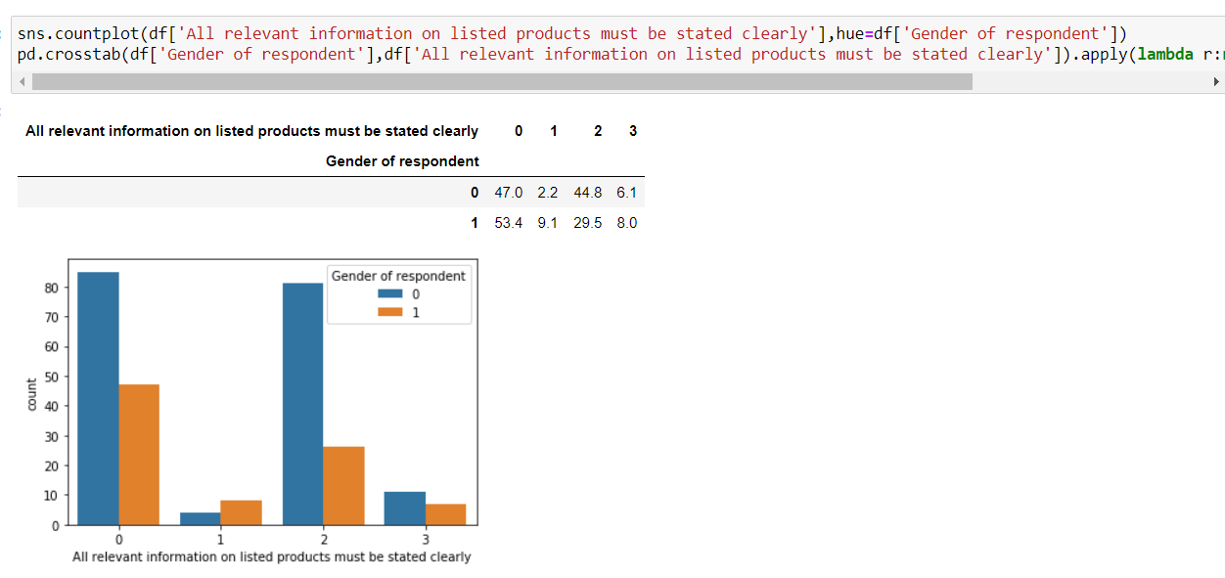
Data Visualization Process
From the above visualization we understand while buying online people do read product listed information before taking the decision whether to go ahead with buying or not, so more than 45% of the shoppers agreed that information should be precisely defined which help us understand the customer knowing the product better.

Slide 17
Interpretation of the Results
I have used various visualization tool to understand the data in a better way.
I have used a few methods for finding the missing value, finding the total shape of the dataset and also used describe method for five-point summary analysis.
I have also used label encoder technique and convert all the data into numerical form to do the data analysis in an easier way.

Slide 18
CONCLUSIONS
I used various visualization methods and understand the EDA in a better way.
This customer satisfaction can be used as an impact of eCommerce market development as well as for economic development of the country.

Slide 19
Learning Outcomes of the Study in respect of Data Science
As per as learning outcomes is concerned, I have learnt the following things
Visualization helps us understand the data graphically.
From describe method we can get some knowledge related to outliers present in the particular columns (large difference between 75th percentile and maximum percentile)
I also understand the about reading various related features and importance of them in the whole dataset.

Slide 20
Challenges And Limitations
Challenges
It was difficult to read each columns and comparing with others on the dataset in notebook as it took some time to understand and analyse it a proper way.
Limitations
Limitations of this work and Scope for Future Work:
Since I have only used a sample dataset, hence sometimes it is difficult to understand the overall impact of this customer feedback at a larger scale.

Slide 21
CUSTOMER RETENTION CASESTUDY
HERE I AM ENDING MY CASE STUDY
ON CUSTOMER RETENTION
Thank you

